Slide 1
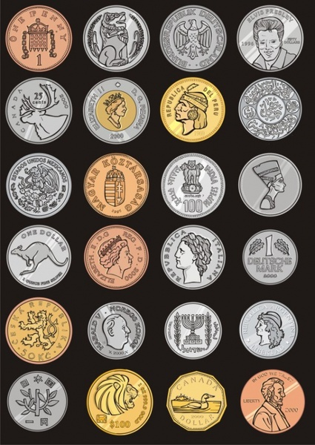
An Investigation of Coins From Around the World
Zoe Apsel, Benjamin Kuster, Victor Villanueva
May 11, 2021

Slide 2
Overview:
Introduce the motivation for the investigation
Give an overview of the four coins we studied
Discuss our goals and techniques used
Analyze data within all four coins
Draw conclusions from the generated data
Recommendations for future research

Slide 3
Introduction
Motivation:
Coins come in all shapes and sizes
Currently cheaper than bills in the long term
Produced by stamping blanks
Many factors go into a nation’s decision for particular coin material
Aesthetics
Cost
Material Hardness
Metal availability

Slide 4
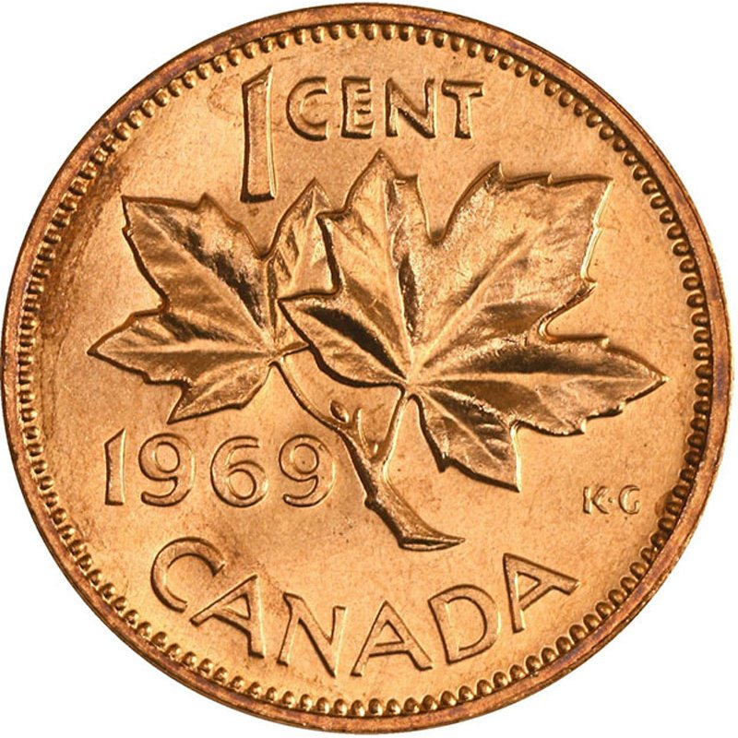
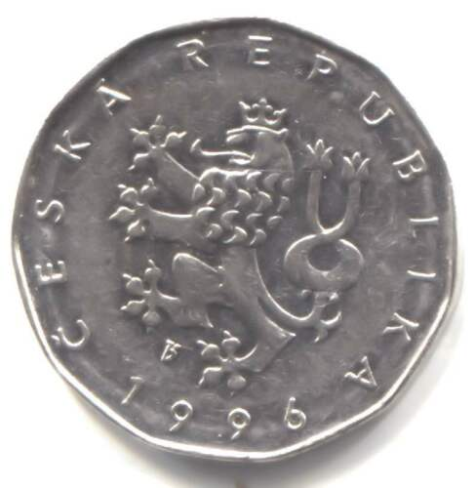
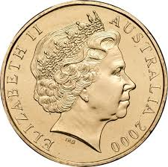
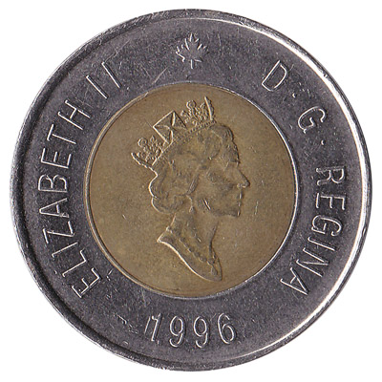
An Introduction to Our Four Coins

Slide 5
Czech Republic One Koruna Coin
One Koruna ≈ 0.05 USD
Issued in 1993, no compositional changes since issuing
Made entirely of nickel-plated steel [2]
Slightly thicker than conventional coins
Thickness of 2.55 mm
https://en.numista.com/catalogue/pieces2155.html

Slide 6
Canadian One Cent Coin
In use since 1858
Until 1996, the coin was 98% Cu, 1.75% Sn, and 0.25% Zn
1997-1999: 98.4% Zn, 1.6% Cu plating
2000-2012: 94% steel, 1.5% Ni, 4.5% Cu plating
Withdrawn from circulation in 2013
Thickness similar to US penny (1.5 mm)
https://www.mint.ca/store/mint/about-the-mint/1-cent-5300004

Slide 7
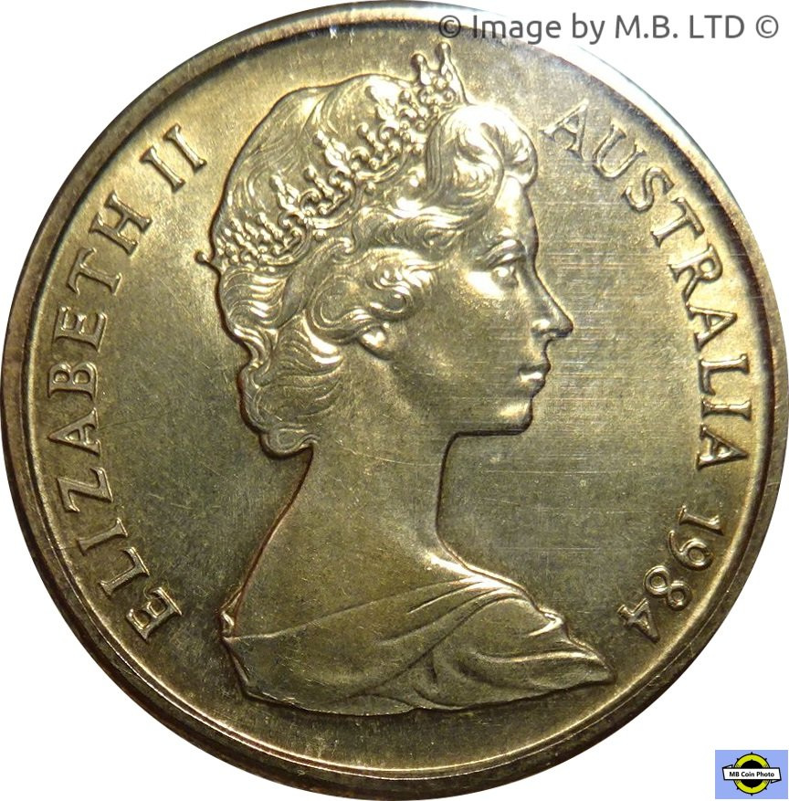
Australian Dollar Coin
Issued in 1984 to replace the one-dollar note
Made of 92% Cu, 6% Al, and 2% Ni
No compositional changes since production
Thickness of 3 mm
https://www.ramint.gov.au/sites/default/files/About%20our%20coins.pdf

Slide 8
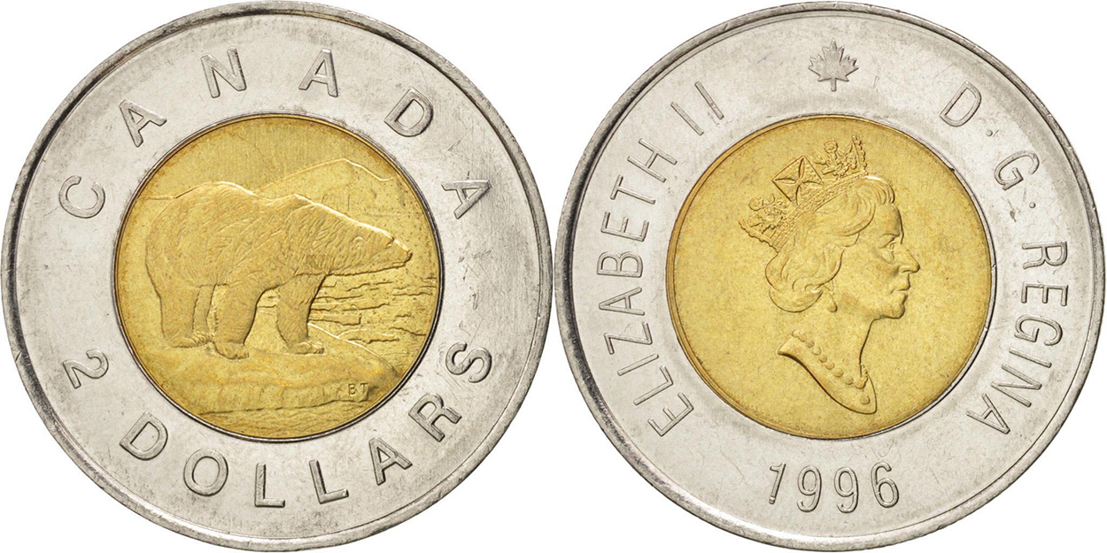
Canadian Two Dollar Coin
Why is it made of two different compositions?
Distinguish the higher value coins
Prevent coin counterfeiting
Same thickness as US quarter (1.75 mm)
1996-2012 Composition: [1]
Outer Ring: 99% Ni
Inner Core: 92% Cu, 6% Al, 2% Ni
2012-Present:
Outer Ring: Nickel plated steel
Inner Core: Brass plated aluminum bronze
Unknown Which Coin we received
https://www.mint.ca/store/mint/about-the-mint/2-dollars-5300016#:~:text=The%202%2Ddollar%20coin%20was,by%20the%20Royal%20Canadian%20Mint.

Slide 9
Goals
Use characterization techniques to identify compositions of different metals
Potentially identify mint time period
Confirm plating material
Hypothesize why each combination of materials was chosen for each coin

Slide 10
Experimental Procedure: Techniques Overview
Techniques used:
Scanning Electron Microscopy (SEM): Microstructural Information
Electron beam directed at sample with emitted electron signals detected
Energy Dispersive X-Ray Spectroscopy (EDS): Compositional Information
Electron beam directed at signal with characteristic and continuum x-rays detected
X-Ray Powder Diffraction (XRD): Structural and Compositional Information
X-rays directed at sample with x-rays detected (characteristic spectrum analyzed)
Vickers hardness testing: Hardness
Sample is indented and the depression left is measured

Slide 11
Results and Interpretation

Slide 12
Coin Hardnesses
 | Czech | Canadian Penny | Australian Dollar | Canadian Two Dollar Interior | Canadian Two Dollar Exterior
HV: | 382.9 | 284.0 | 395.6 | 441.8 | 500.6
Coins should be above a minimum threshold
Retain their shape and structural integrity
Hardness of two-phase coin especially important
Harder exterior improves durability

Slide 13
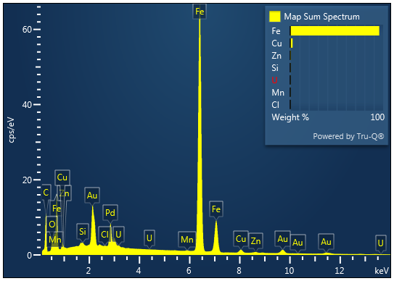
Czech One Koruna: EDS Overview
Showed primarily iron with secondary amounts of copper
Nickel misidentified as copper, why?
Many trace elements shown in EDS
Au and Pd from coating
Uranium misidentified, why?
Don’t take EDS results at face value

Slide 14
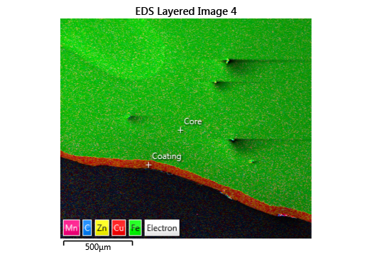
Czech One Koruna: EDS Point ID
The EDS map showed primarily iron core with Cu-Zn coating at edge
Agrees with expected overall structure of Czech coin (core and coating)
Coating:
75.47% Cu, 23.83% Zn
Core:
99.5% Fe
EDS properly showed two phases but misidentified their composition

Slide 15
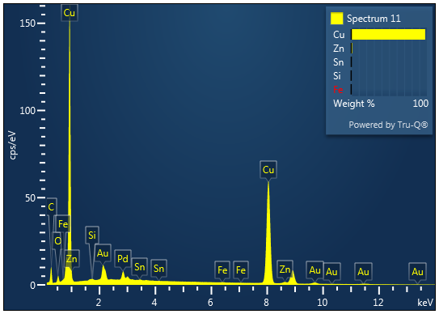
Canadian One Cent (1971): EDS Overview
Components identified according to EDS: 97.7% Cu, 1.5% Zn, 0.5% Sn
EDS data identifies three primary elements which match the expected results
However, tin is undercounted and zinc is overcounted
EDS is effective for qualitative analysis, but suffers during quantitative analysis.

Slide 16
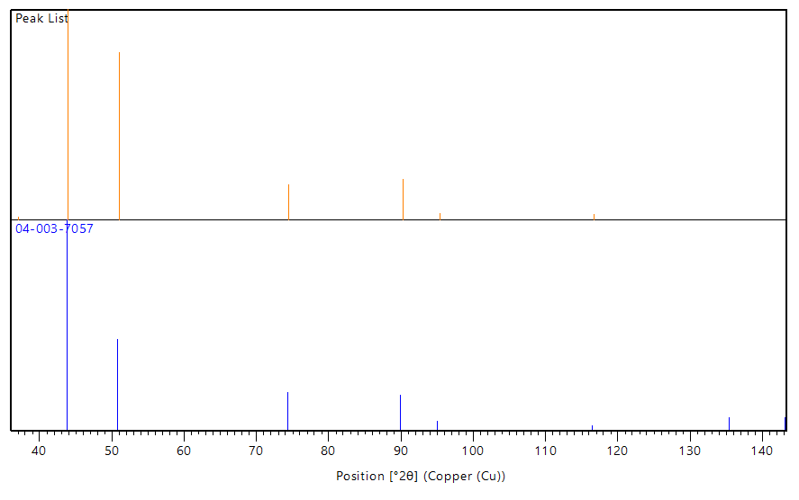
Canadian One Cent: XRD data
XRD pattern matched that of the 97% Cu, 3% Sn reference
No Zinc detected
More consistent with expected results
Using XRD to compare spectra to the known database can give the most likely compositions.

Slide 17
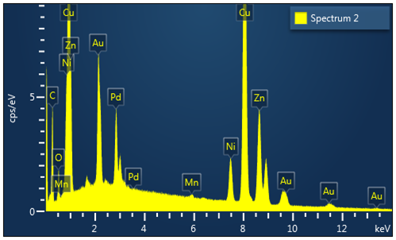
Australian One Dollar: EDS Findings
Components identified in XRD:
Copper
Components identified in EDS:
Copper- 67.71 wt %
Zinc- 24.15 wt %
Nickel- 6.22 wt %
Neither method identified aluminum
Neither method identified zinc in the expected amount
Based on expected results and XRD, this EDS data set is inaccurate.

Slide 18
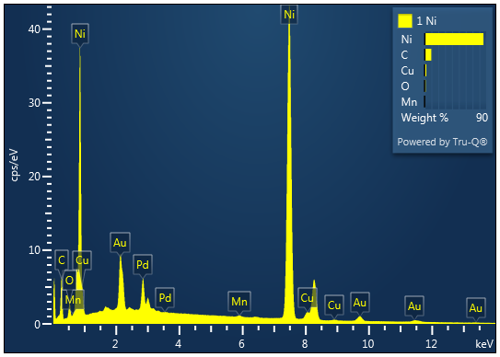
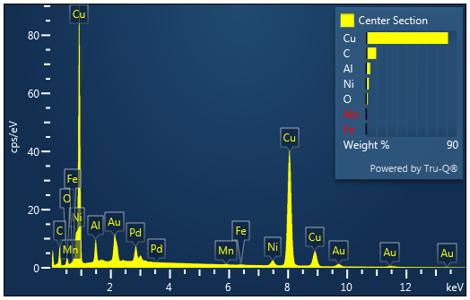
Canadian Two Dollar: EDS Overview
Phase 1: Primarily Ni, trace amounts of Cu
Phase 2: Primarily Cu, trace amounts of Al and Ni
Identifies coin as minted between 1996 and 2012
Outer ring is made primarily of nickel and inner core is made primarily of copper

Slide 19
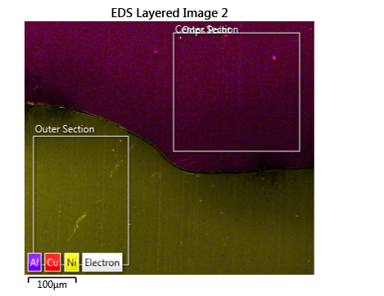
Canadian Two Dollar: EDS Point ID
Edge:
Components identified:
Nickel (89%)
Center:
Components identified:
Copper (87%)
Coin was identified as from 1996-2012

Slide 20
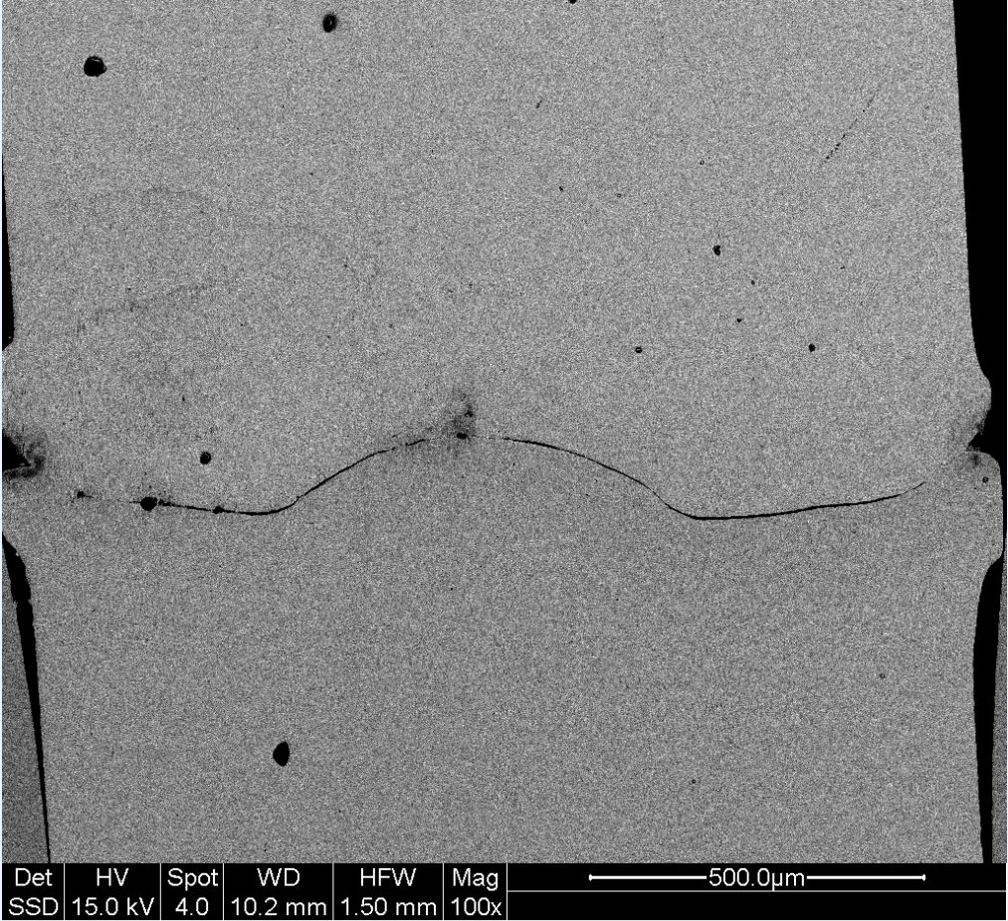
Canadian Two Dollar: Hardness and Boundary Shape
The inner core’s hardness is lower than that of the exterior ring
Exterior ring protects inner core
Shape of boundary between them, result of stamping process
Also acts as a fastener to keep the two pieces together
Hard exterior protects softer core.

Slide 21
Metal Cost Comparison
The Czech coin is the only coin made mostly of the cheapest material included (steel)
Other coins are made mostly of copper or nickel, despite having other cheaper components
Zinc and aluminum
Australia is one of the leading producers of copper
Canada is a leading producer of nickel and copper
Raw cost of coin material is not necessarily optimized
Metal | Price Per Ton (USD)
Steel | 603.52
Aluminum | 2540.48
Zinc | 3037.50
Copper | 10724.50
Nickel | 18070.00
Tin | 33097.00
https://www.metalcentergroup.com/metal-prices
https://www.focus-economics.com/commodities/base-metals/steel-usa
https://markets.businessinsider.com/commodities/aluminum-price
https://www.statista.com/statistics/264626/copper-production-by-country/#:~:text=The%20ten%20leading%20countries%20in,Mexico%2C%20Russia%2C%20and%20Kazakhstan
https://investingnews.com/daily/resource-investing/base-metals-investing/nickel-investing/nickel-mining-in-canada/
https://www.nrcan.gc.ca/our-natural-resources/minerals-mining/minerals-metals-facts/copper-facts/20506

Slide 22
Unexplained EDS and XRD Artifacts
Multiple different trace elements in each EDS scan
Fe and Mn frequently appeared and were excluded from some scans
XRD scan was unable to identify elements present in small amounts
Ability of XRD to identify a component is completely dependent on the database of patterns used
Both EDS and XRD data incorrectly identify the coating on the Czech Koruna
Approximately 75% copper and 25% zinc

Slide 23
Conclusion
Each of the coins, and their mints when appropriate, were identified
The Australian dollar coin had errors in the compositional data
Each of the separate phases in the coins with two phases were confirmed
The plating and core of Czech Koruna
Inner and outer portions of Canadian two dollar coin
Construction of the coins did not primarily depend on the material properties of the substance used
Price of the materials
Accessibility of the materials
Material met general hardness threshold

Slide 24
Recommendations for future work
More Specified Research
More coins from same country
Further Research into Coin Manufacturing
Information on crystal structure and grains if needed
Rolling, casting, stamping

Slide 25
Acknowledgements
Special thanks to:
Professor Ihlefeld
Ian Brummel

